Slide 1



The Singularity Is Near: Book By Kurzweil
Ray Kurzweil's book, "The Singularity Is Near," explores the idea of a technological singularity—a point in the future where artificial intelligence surpasses human intelligence, leading to unpredictable consequences.
by Paman APIQ
PA

Slide 2


What is the Singularity?
Exponential Growth
Technological advancements are accelerating at an exponential rate, doubling in power every 18 months, a phenomenon known as Moore's Law.
Artificial Intelligence
AI is rapidly evolving, with algorithms becoming more sophisticated and capable of complex tasks previously thought to be uniquely human.
Converging Technologies
Different technologies are merging, creating new possibilities. Examples include nanotechnology, biotechnology, and artificial intelligence.

Slide 3

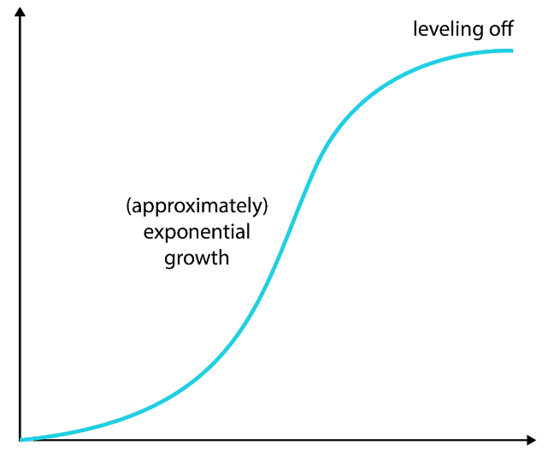
Exponential Growth of Technology
1
Moore's Law
The number of transistors on an integrated circuit doubles every two years.
2
Data Explosion
The amount of data generated and stored globally is increasing exponentially.
3
Computational Power
The speed and capacity of computers are continuously improving.

Slide 4


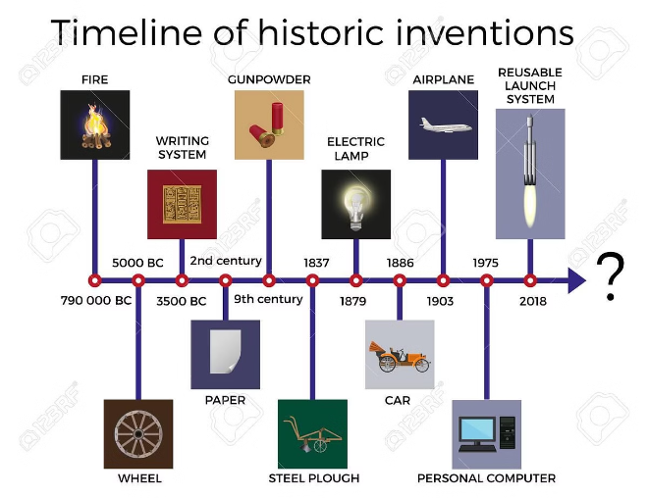



Accelerating Pace of Technological Change
Early 20th Century
Radio, telephone, automobile, airplane.
Mid 20th Century
Television, computers, nuclear energy.
Late 20th Century
Internet, mobile phones, personal computers.
21st Century
Artificial intelligence, biotechnology, nanotechnology.

Slide 5
Convergence of Key Technologies
Nanotechnology
Biotechnology
Artificial Intelligence
Manipulating matter at the atomic and molecular level.
Using biological systems and processes to solve problems.
Creating machines capable of human-like intelligence.

Slide 6

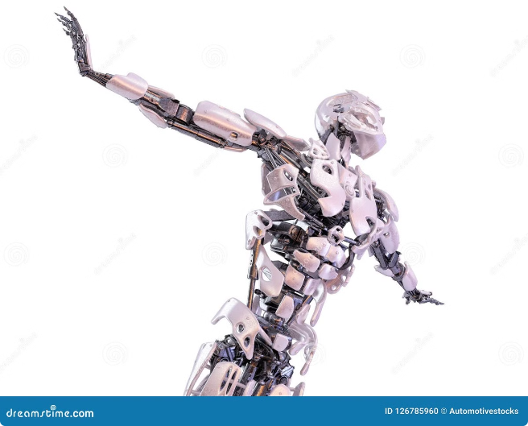
Implications of the Singularity
1
Human Enhancement
Possibilities include increased lifespan, intelligence, and physical capabilities.
2
Economic Disruption
Automation could lead to job displacement and significant economic changes.
3
Ethical Concerns
Questions arise about the responsible development and use of powerful technologies.
4
Existential Risks
The potential for unintended consequences and loss of control over technology.

Slide 7

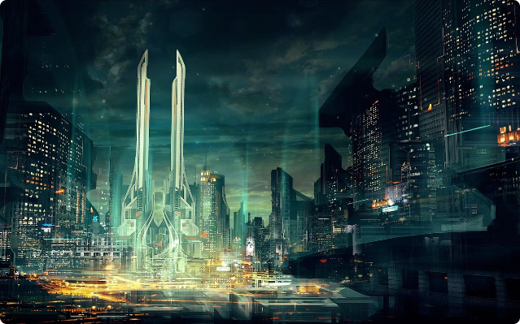
Kurzweil's Predictions for the Future
2029
AI surpasses human intelligence.
2045
Singularity occurs, leading to rapid technological advancement.
2100
Humans and technology merge, creating a new form of existence.

Slide 8


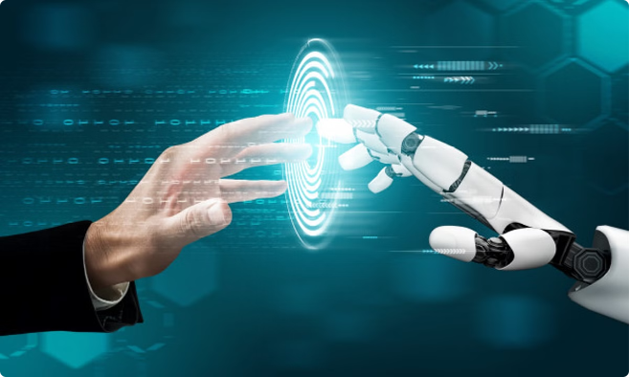


The Impact on Humanity
Cognitive Enhancement
AI could augment human intelligence and creativity, leading to new discoveries and innovation.
Medical Advancements
Nanotechnology and AI could revolutionize healthcare, leading to cures for diseases and increased lifespan.
Global Transformation
The Singularity could have profound implications for society, politics, and the environment.

Slide 9


Preparing for the Singularity
1
Education
Lifelong learning is crucial to adapt to rapidly evolving technologies.
2
Collaboration
Working together to solve complex problems and address ethical challenges.
3
Critical Thinking
Developing the ability to analyze information, evaluate risks, and make informed decisions.

Slide 10



Potential Risks and Challenges
Weaponization of AI
Cybersecurity Threats
Job Displacement
The potential for AI to be used for malicious purposes, such as autonomous weapons systems.
Vulnerabilities in AI systems could be exploited by hackers, leading to data breaches and system failures.
Automation could lead to widespread unemployment, requiring new economic models and social safety nets.

